Slide 1
CS5543 Real-Time Big Data Analytics Feature Extraction – Audio
Tutorial 14

Slide 2
Audio Data
The following link provides a brief explanation
http://blogs.msdn.com/b/dawate/archive/2009/06/22/intro-to-audio-programming-part-1-how-audio-data-is-represented.aspx

Slide 3
Work Flow for Audio Classification
Audio Files
Feature Extraction
Classification
(Machine Learning)
Feature Extraction is based on jAudio
Machine Learning is based on weka

Slide 4
Feature Extraction : jAudio
The following are the list of Main Features from Audio
Spectral Centroid
Spectral Rolloff Point
Spectral Flux
Compactness
Spectral Variability
Root Mean Square
Fraction of Low Energy Windows
Zero Crossings
Strongest Beat
Beat Sum
MFCC
ConstantQ
LPC
Method of Moments
Peak Detection
Area Method of MFCCs

Slide 5
Features Extracted in current implementation
Zero Crossings
The number of times the waveform changed sign. An indication of frequency as well as noisiness.
LPC : Linear Predictive Crossings
Linear Prediction Coefficients calculated using autocorrelation and Levinson-Durbin recursion.

Slide 6

Sample Output
Zero Crossings : 146
LPC: -0.997926
Kick
Zero Crossings : 5058
LPC: -0.798823
Snare

Slide 7
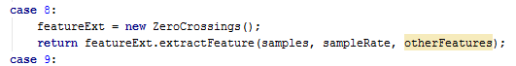
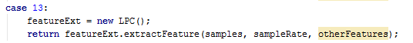
Implementation

Slide 8
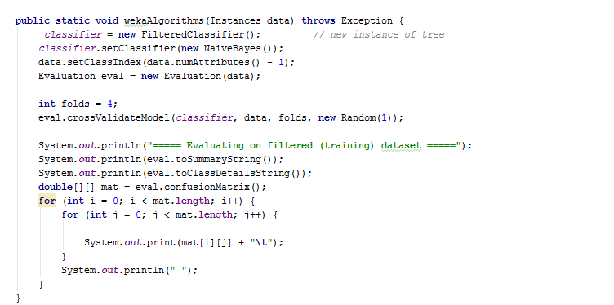
Machine Learning using Weka

Slide 9
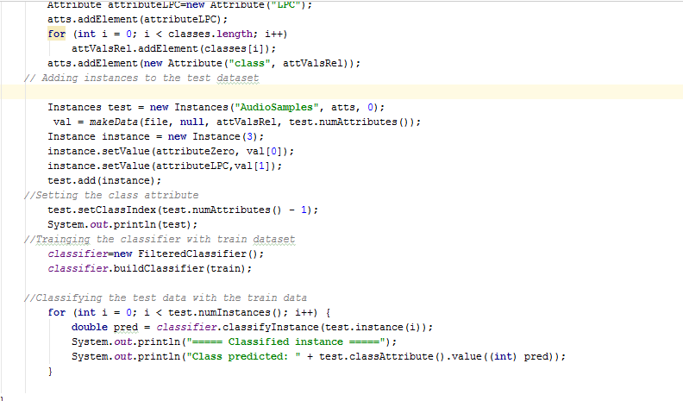
Classification using Weka

Slide 10
Results
===== Evaluating on filtered (training) dataset =====
Correctly Classified Instances 94 97.9167 %
Incorrectly Classified Instances 2 2.0833 %
Kappa statistic 0.9556
Mean absolute error 0.0542
Root mean squared error 0.1568
Relative absolute error 11.6647 %
Root relative squared error 32.5526 %
Total Number of Instances 96

Slide 11
Results
=== Detailed Accuracy By Class ===
TP Rate FP Rate Precision Recall F-Measure ROC Area Class
1 0.033 0.946 1 0.972 0.99 kick
0.967 0 1 0.967 0.983 0.99 snare
Weighted Avg. 0.979 0.012 0.98 0.979 0.979 0.99
========= Confusion Matrix =========
35.0 0.0
2.0 59.0

Slide 12
References
jAudio : http://jaudio.sourceforge.net/
jMIR : http://jmir.sourceforge.net/
Weka: http://www.cs.waikato.ac.nz/ml/weka/
Weka Documentation : https://weka.wikispaces.com/Use+WEKA+in+your+Java+code

